Slide 1

Asp.net Core
The gateway corp.

Slide 2
Introduction & Purpose
Binkal Patel
Technical Leader
The Gateway Corp.

Slide 3
What is Asp.net core?
Web framework from the Microsoft
Redesigned asp.net to be faster, flexible and work for any platform
ASP.NET Core is the framework that can be used for web development with .NET.
ASP.NET Core is an open source and cloud-optimized web framework.
Used for developing modern web applications that can be developed and run on Windows, Linux and the Mac.
Includes MVC Framework
Combines feature of MVC and Web Api in single web application programming framework

Slide 4
What is Asp.net core?
ASP.NET Core apps can run on .NET Core or on the full .NET Framework.
architected to provide an optimized development framework for apps that are deployed to the cloud or run on-premises.
It consists of modular components with minimal overhead,
flexible while constructing solutions.
develop and run your ASP.NET Core apps cross-platform on Windows, Mac and Linux.

Slide 5
Advantages of ASP.NET Core
ASP.NET Core has a number of architectural changes that result in a much leaner and modular framework.
ASP.NET Core is no longer based on System.Web.dll.
It is based on a set of granular and well factored NuGet packages.
allows to optimize app to include just the NuGet packages needed.
The benefits of a smaller app surface area include tighter security, reduced servicing, improved performance, and decreased costs
Cloud-ready environment-based configuration.
Built-in support for dependency injection.
Tag Helpers which makes Razor markup more natural with HTML.
Ability to host on IIS or self-host in your own process.

Slide 6
Evolution
Asp(classic ASP) – 1996
Asp.Net web forms – 2002 (statemanagement, viewstates)
First time introducted code behind
ASP.Net MVC - 2009
Overcome issues of ASP.Net
Unit test
Separation of concern
Created on top of web platform component
Created before cloud platform
Asp.net core – 2016
New .net core framework
First version of .net
2017 – core 2
Sep. 2019 – core 3

Slide 7
Tools
Visual Studio 2019
https://visualstudio.microsoft.com/vs/
Sql Server 2017 or higher
https://www.microsoft.com/en-au/sql-server/sql-server-downloads
Asp.net Core
https://dotnet.microsoft.com/download/dotnet-core/3.0
Visual studio code
https://code.visualstudio.com/docs/?dv=win
Dotnet Cli
Node js
Npm

Slide 8
Fundamentals & project structure walkthrough
Create first .net core application using vs 2019
Create first .net core application using dotnet cli and VS code
.csproj file
Launchsetting.json
Wwwroot
Razor pages
Page folder

Slide 9
.CSPROJ
csproj file
Containing framework information
Installed nugget packages
Prior to .net core 3.0 meta packages were installed automatically as a part of project thru Nuget package
In .net core 3 it is a part of .net core installation

Slide 10
Launchsetting.json
Launchsettings.json
What to do when execute application
Default profiles created
Iisexpress
Project profile – cli
Navigate and validate the project properties

Slide 11
Tag Helpers
New in asp.net core
Server side component
Similar to html helpers
In order to use it, required to import it first (_ViewImports)
@addTagHelper *,Microsoft.AspNetCore.Mvc.TagHelpers

Slide 12
wwwroot
Containing css, js and lib
Used to be store css,js and other libraries
No other files
Same as assets in angular
To separate static files from the application pages

Slide 13
Razor ages
Introduced first time in .net core 2.0
New feature of .net core mvc for coding page
Simple way to do the same as we are doing with mvc
Razor pages have 2 parts
Razor page - UI
Page model – contain handler – controller
Contain all the methods like get , put post with prefix “On”

Slide 14
pages
Shared folder
Partial views
Partial pages
Shared layout
Validation scripts partial
Containg the script only
ViewImport.cshtml (Global declaration)
Contains name space
Taghelpers
Viewstart.html
Which master page is to be used by default
Erros page
Redirection page in case any error occurred

Slide 15
Routing
What is routing ?
Used to matches url – file paths
Rules
Required root folder (pages)
We Can add areas
Index.cshtml will be default route
How URL and page mapped in routing
No need to write explicit routing rule
Following the path location strategy

Slide 16
Action Results
Action result is result of all action methods
Is a parent class of many derived classes
iAction result return type is to be used when may types can be returned
Action results in Razor pages
Content result – to return text/html, application/json
File content result – file from byte array , virtual path
Notfountresult – 404 not found
Pageresult – process and return result of page
Partialresult – return partial page
Redirecttopageresult – redirects user to specified page
View component result – result of executing viewcomponent

Slide 17
How Bootstrapping asp.net core application
Main method
Startup
Middleware
App settings

Slide 18
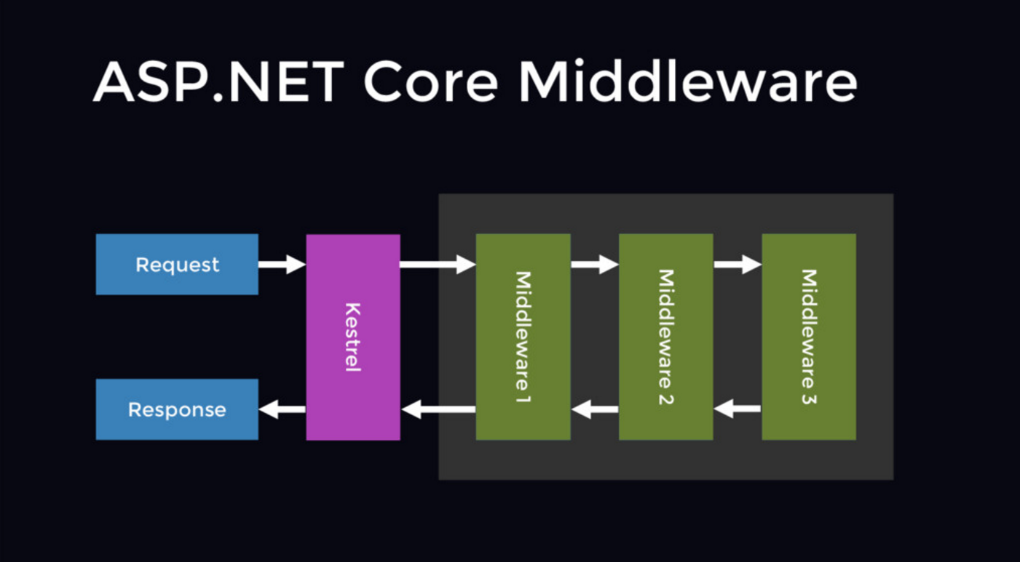
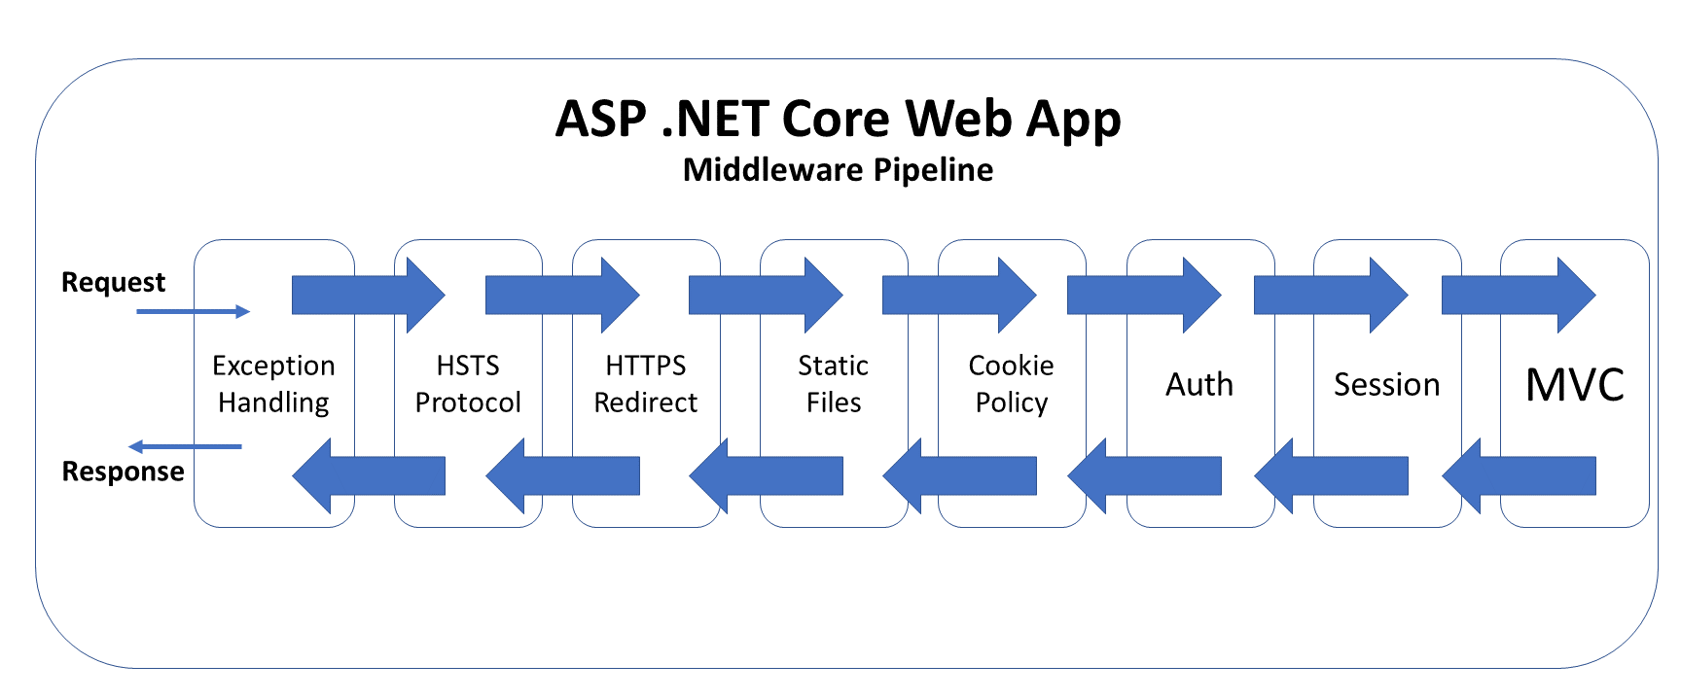
Middle Ware
What is Middle ware?
Middleware in ASP.NET Core are software components that are specifically orchestrated in the application pipeline to handle requests and responses.
Each component can choose to potentially modify and let the request thru to the next component or immediately return a response based on specific implementation logic.
Notes:
What is Middle ware?
Middleware in ASP.NET Core are software components that are specifically orchestrated in the application pipeline to handle requests and responses.
Each component can choose to potentially modify and let the request thru to the next component or immediately return a response based on specific implementation logic.
What is kestrel ?
Kestrel is a cross-platform web server for ASP.NET Core. Kestrel is the web server that's included by default in ASP.NET Core project templates.
Kestrel can be used by itself or with a reverse proxy server, such as Internet Information Services (IIS), Nginx, or Apache. A reverse proxy server receives HTTP requests from the network and forwards them to Kestrel.
https://docs.microsoft.com/en-us/aspnet/core/fundamentals/servers/kestrel?view=aspnetcore-3.0

Slide 19
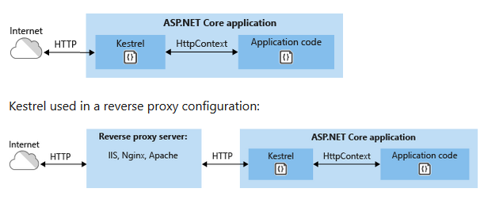
HTTPContext & Middleware pipe line

Slide 20
appsettings
All application specific settings written in this file
File name will be appsettings. Json
Any changes to this file required restart app on iis to take effect

Slide 21
Dependency injection
What is dependency injection?
.netcore is designed from scratch to support dependency injection
It will be used to inject dependency class through constructor or method by using in built IOC container
DI is a pattern that can help developer to decouple the difference piece of code – module
Framework service and application service can be injected in class in .net core
Do not need to write and use an individual dependency containers and libraries
Container is responsible for create and manage instance of the class as and when required

Slide 22
API Controllers
Api contollers can be added to the same MVC application like we had in previous version of MVC.
Api controllers need to be registerd in the starup orchestration
In configure service method of startup class
Services,AddControllersWithViews()
services.AddControllers();
Required to add the same in middleware section of the application
App.UseEndpoints(endpoints=>
{
endpoints.MapRazorPages();
endpoints.MapControllers();
});

Slide 23
API Controllers
Routing can be defined same as web api routing using [Route(“api/controller”)]
To make any controller as API Controller need to add [ApiController] attribute on top of controller

Slide 24
MVC application
MVC
Model ?
View ?
Controller ?
Controller > model > view
Controller > view > model
Notes:
Model : is a class with properties,Normally represents the data entities of business entities /view models
View : user interface , normally it is created based on the models
Controllers : heart of mvc application, handles all interaction with the frontend using HTTP Request. Worked with the model and select views to display UI

Slide 25
MVC Routing
App.UseEndpoints(endpoints=>
{
endpoints.MapControllersRoute(
name: “defalult”,
Pattern: “{controller=Home}/{action=Index}/{id?}”
);
endpoints.MapRazorPages
});

Slide 26
URL Patterns
DomainName/Controller/Action/Parameters
DomainName/AreaName/Controller/Action/Parameters

Slide 27
Routing with Area
App.UseEndpoints(endpoints=>
{
endpoints.MapControllersRoute(
name: “defalult”,
Pattern: “{area=Users}/{controller=Home}/{action=Index}/{id?}”
);
endpoints.MapRazorPages
});
Areaname has to be added on top of controller name
[Area(“Users”)]
Copy _viewimports.cshtml and _viewStart.cshtml to area’s view folder
Notes:
Microsoft.AspNetCore.MVC.Razor.RuntimeCompilation packages to be added
- services.AddRazorpages().AddRazorRuntimeCompilation();

Slide 28
.Net Core Security – Using identity
.net Core Identity implementation

Slide 29
Filters
It will allow ASP .NET Core to be run after or before specific stage in the request processing pipe line
There are 2 built-in filters available
Authorization
Response Caching
Custom filters can be created to handle cross cutting concerns
Error Handling
Caching
Configuration
Authorization
Logging

Slide 30
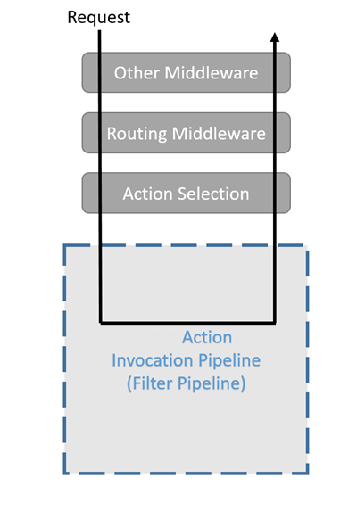
How Filter Works? Types of Filters
Authorization
Resource
Action
Exception
Result
Notes:
Authorization filters run first and are used to determine whether the user is authorized for the request. Authorization filters short-circuit the pipeline if the request is unauthorized.
Resource filters: Run after authorization.
OnResourceExecuting can run code before the rest of the filter pipeline. For example, OnResourceExecuting can run code before model binding.
OnResourceExecuted can run code after the rest of the pipeline has completed.
Action filters can run code immediately before and after an individual action method is called. They can be used to manipulate the arguments passed into an action and the result returned from the action. Action filters are not supported in Razor Pages.
Exception filters are used to apply global policies to unhandled exceptions that occur before anything has been written to the response body.
Result filters can run code immediately before and after the execution of individual action results. They run only when the action method has executed successfully. They are useful for logic that must surround view or formatter execution.

Slide 31
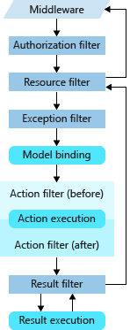
Filter Sequence
Filters support both synchronous and asynchronous implementations through different interface definitions.
Synchronous filters can run code before (On-Stage-Executing) and after (On-Stage-Executed) their pipeline stage.
OnActionExecuting is called before the action method is called. OnActionExecuted is called after the action method returns.

Slide 32
Sync and Async Filter
synchronous filters define an On-Stage-Executionmethod:
public class MySampleActionFilter : IActionFilter
{
public void OnActionExecuting(ActionExecutingContext context)
{
// Do something before the action executes.
}
public void OnActionExecuted(ActionExecutedContext context)
{
// Do something after the action executes.
}
}
Asynchronous filters define an On-Stage-ExecutionAsync method:
public class SampleAsyncActionFilter : IAsyncActionFilter
{
public async Task OnActionExecutionAsync(
ActionExecutingContext context,
ActionExecutionDelegate next)
{
// Do something before the action executes.
// next() calls the action method.
var resultContext = await next();
// resultContext.Result is set.
// Do something after the action executes.
}
}

Slide 33
Filter scopes and order of execution
A filter can be added to the pipeline at one of three scopes:
Using an attribute on an action.
Using an attribute on a controller.
Globally for all controllers and actions as shown in the following code:
public void ConfigureServices(IServiceCollection services)
{
services.AddMvc(options =>
{
options.Filters.Add(new AddHeaderAttribute("GlobalAddHeader",
"Result filter added to MvcOptions.Filters")); // An instance
options.Filters.Add(typeof(MySampleActionFilter)); // By type
options.Filters.Add(new SampleGlobalActionFilter()); // An instance
}).SetCompatibilityVersion(CompatibilityVersion.Version_2_2);
}

Slide 34
Default order of execution
Sequence | Filter Scope | Filter Method
1 | Global | OnActionExecuting
2 | Controller | OnActionExecuting
3 | Method | OnActionExecuting
4 | Method | OnActionExecuted
5 | Controller | OnActionExecuted
6 | Global | OnActionExecuted
https://docs.microsoft.com/en-us/aspnet/core/razor-pages/filter?view=aspnetcore-3.0#implement-razor-page-filters-by-overriding-filter-methods
https://docs.microsoft.com/en-us/aspnet/core/mvc/controllers/filters?view=aspnetcore-3.0#filter-scopes-and-order-of-execution
Notes:
https://kimsereyblog.blogspot.com/2017/04/filters-in-asp-net-core-what-are-they.html

Slide 35
Tag helpers
Similar to angular directives
Introduced in only asp.net core
Enables server side coding and rendering html
Focused around HTMl elements
i.e. asp-area, asp-page
Similar to html helper
Syntax is different
Examples
Anchor
Image
Environment
form
Why Tag Helpers
Custom Tag Helper
Notes:
Why : custom company name append to route
asp-append-version for image
Environment taghelpers
asp-dallback-href
asp-fallback-test-calss=“sr-only”
asp-fallback-test-property=“sr-only”
asp-fallback-test-value=“position”
asp-fallback-test-calss=“absolute”
asp-suppress-fallback-integrity=“true”
Form
Input
Label
Select

Slide 36
